Slide 1

Transforming Homes, Elevating Values

Slide 2
Introduction and Objectives
Background of the study
Business Overview:
Welcome to RenoStrategix, where the realms of real estate and home renovations converge. This project addresses a pressing issue faced by CasaCrafters Realty Solutions: the need to provide data-driven guidance on home improvements for increased property value. Our focus is not only on boosting value but also on enhancing overall appeal, guided by multiple linear regression modelling using King County house sales data.
Business Problem:
Homeowners often grapple with the challenge of deciding on renovations that significantly enhance property values. CasaCrafters aims to fill this void by offering tailored advice grounded in a thorough analysis of the King County real estate market.
Objectives 1
Identify Key Features: Develop a multiple linear regression model to identify and quantify the impact of features (e.g., square footage, bedrooms) on house sale prices in King County.
Objectives 2
Build a Predictive Model: Construct a robust regression model predicting house sale prices based on selected features for personalized property valuation.
Objectives 3
Provide Renovation Recommendations: Utilize the regression model to generate personalized recommendations, suggesting renovations predicted to have the highest positive impact on property values.
Navigating the intricate realm of real estate, CasaCrafters provides homeowners with personalized advice, addressing the challenge of deciding on renovations that both fulfill personal desires and significantly enhance property values in the dynamic landscape of King County.

Slide 3
Rationale for achieving the objectives
Rationale
Identify Key Features:
Rationale:
Understanding the features influencing property values is crucial for targeted homeowner recommendations. By analysing historical data, the model reveals key features impacting sale prices, empowering CasaCrafters to guide homeowners on high-return renovations.
Provide Recommendations
Rationale:
CasaCrafters aims to be a trusted advisor, offering tailored recommendations aligned with homeowners' visions and expected to yield the greatest ROI. This proactive approach enhances CasaCrafters' services, fostering trust and satisfaction among homeowners.
Build a Predictive Model
Rationale:
The predictive model serves as a tool for estimating the impact of specific renovations on property value. Homeowners can input proposed changes, receiving personalized predictions for informed decision-making aligned with goals and maximizing ROI.

Slide 4

Data Understanding
Data source, preparation and use
We worked with past data from Kings county.
Data Preparation;
The initial step involves importing the data file into our working environment and conducting an exploratory analysis to gain a foundational understanding of the dataset.
This phase is crucial for identifying necessary data wrangling techniques essential to transform the data into an analyzable and model-ready format.
Exploratory Data Analysis;
This phase encompasses several key activities:
Examining the dataset's structure.
Scrutinizing the dataset's properties.
Comprehending the dataset's description.
Sampling the initial five rows of the dataset.

Slide 5
Data Manipulation
The process flow
This involved activities;
• Checking the shape of the dataset. • Inspecting the properties of the dataset. • Understanding the description of the dataset. • Sampling the 1st 5 rows of the dataset
Conclusions based on the analysis outcome and a We utilized the interquartile range method to detect outliers in the price column, plotting a boxplot. A total of 1153 outliers were identified, with a lower bound of -162,500.0 and an upper bound of 1,129,500.0
We used historical data based on how renovation of houses has influenced the return on investment
Data Pre-Processing
Data cleaning and Manipulation
Categorical Variables
Data
Exploratory data analysis
Outlier Detection
Identification of variables that represent categories or groups. Categorical variables consist of discrete categories or labels in this case they were represented in the 'waterfront', 'view', 'condition', and 'grade' columns.
The initial step involves importing the data file, exploring it for an initial dataset understanding, and determining data wrangling techniques for analysis and modeling.
Assessed the null values across all columns, identifying columns with missing data.
We replaced the missing values respectively
Furthermore, we checked the data types for the columns and adjusted them respectively e.g. date column to datetime data type
We also created a new column from the difference between year built and year renovated to get the no. of it took to before renovation

Slide 6
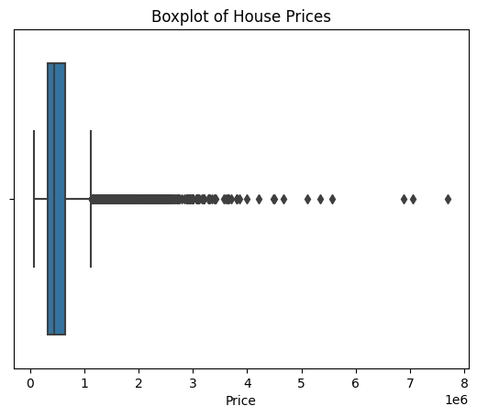
Outliers
Price outliers
We examine the price column for outliers through the interquartile range method and visualize them using a boxplot. We observed 1153 outliers, with the lower bound set at -162,500.0 and the upper bound at 1,129,500.0

Slide 7
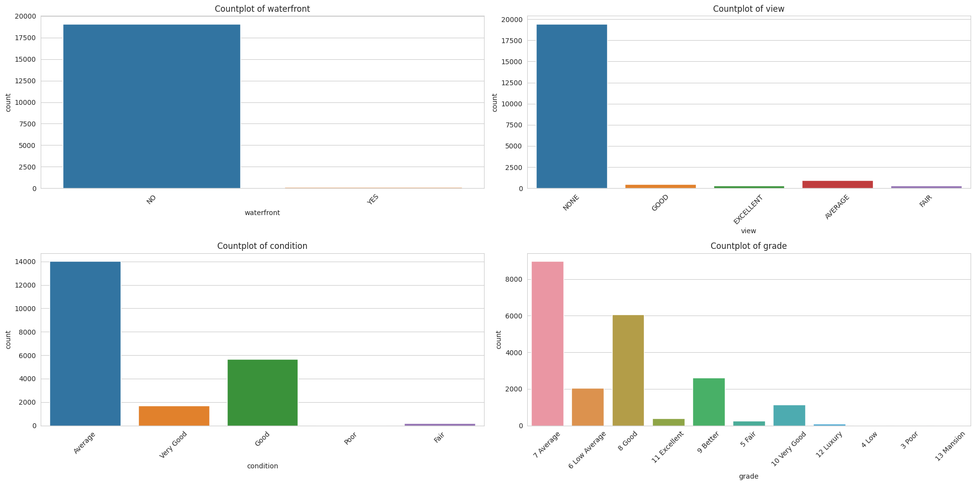
Grouped variables
Categorical variables
We examine the price column for outliers through the interquartile range method and visualize them using a boxplot. We observed 1153 outliers, with the lower bound set at -162,500.0 and the upper bound at 1,129,500.0

Slide 8
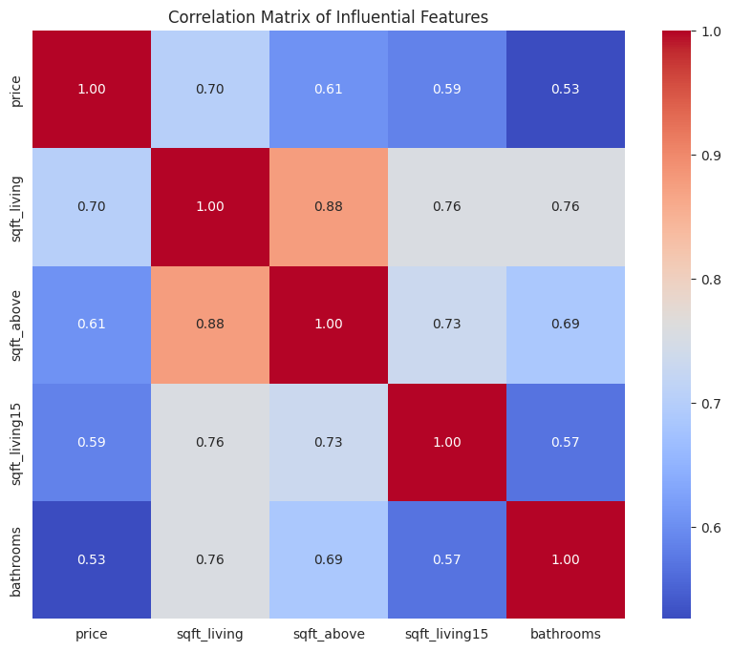
Feature Selection
Identifying the most influential features through analysis and correlation
Using Pearson correlation in pandas, we obtained the correlation matrix for all the numerical columns in the dataset. To the right is the representation of the correlation in the correlation matrix;

Slide 9
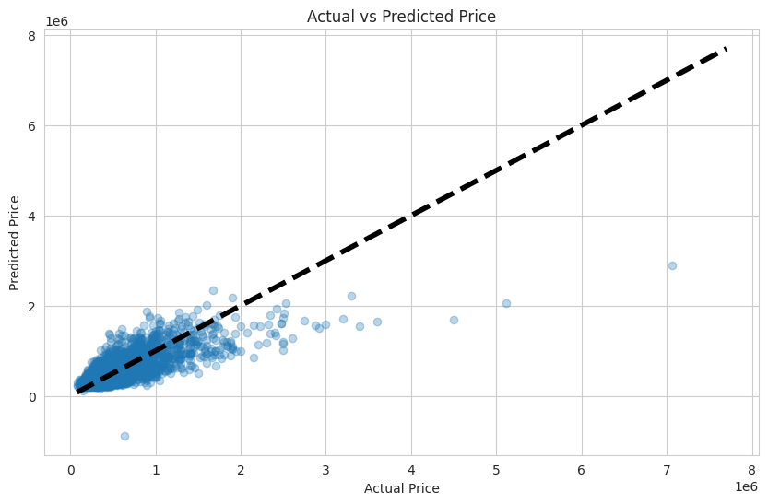
Modeling Building
Train a multiple linear regression model using the selected features
Build a multiple linear regression model with the selected features, including 'sqft_living,' 'sqft_above,' 'sqft_living15,' 'bathrooms,' 'grade_11 Excellent,' 'view_NONE,' 'grade_10 Very Good,' 'grade_7 Average,' and 'bedrooms.’
Splitting the data into training and testing sets, we trained the model and assessed its performance by predicting test results.
The Mean Squared Error (MSE) is 58,286,402,686.66, representing the average squared difference between predicted and actual prices.
The R-squared value of 0.55 indicates the proportion of variance in house prices explained by the selected features, with a higher value suggesting a better fit. View the scatter plot below for a visual representation of predicted and actual values.

Slide 10
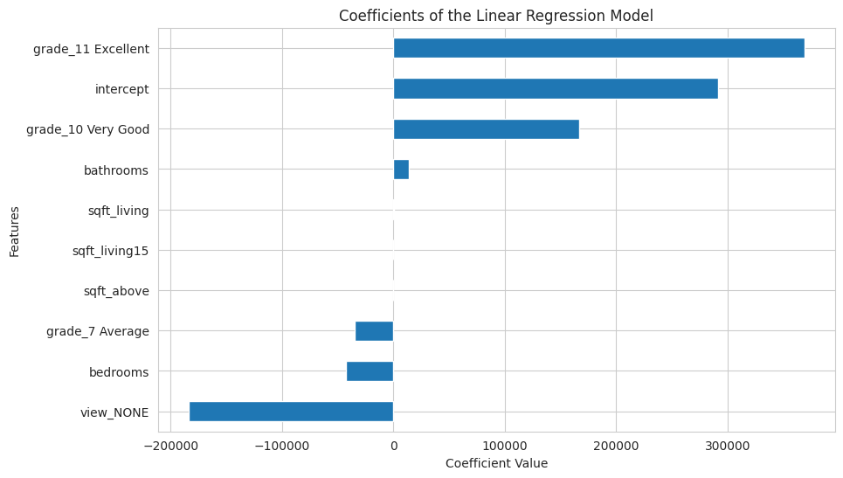
Modeling Evaluation
Assessing the performance of the model and interpreting the coefficients
We used the mean squared Error to assess the model. This metric (MSE) measures the average absolute difference between the predicted and actual values. It provides a measure of the average magnitude of errors in the model's predictions.
Coefficients: The coefficients represent the weights assigned to each feature in the linear regression model. Positive coefficients indicate a positive correlation with the target variable, while negative coefficients indicate a negative correlation. The intercept represents the estimated value of the target variable when all features are zero.

Slide 11
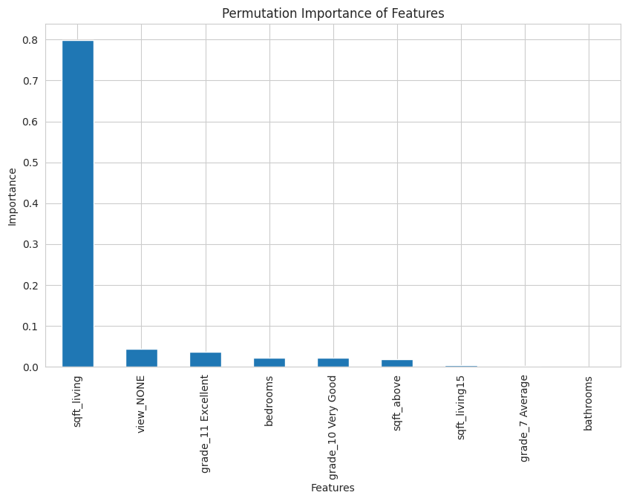
Recommendation System
Developing a system to recommend specific renovations based on their predicted impact on house prices
Identified renovation-related features and their coefficients, creating a Data Frame that sheds light on the linear regression model's predictions. These coefficients estimate the price change for a one-unit increase in each respective feature, offering insights into the potential impact of renovations on house prices.
Sqft_living holds the highest importance score, signifying that alterations in living area square footage have the most significant potential impact on house prices.
Sqft_above, representing above-ground square footage, possesses a comparatively lower importance score.
Bathrooms exhibit an extremely low importance score, indicating a minimal impact on house prices within this model.
The results advise focusing on expanding sqft_living in renovations for the highest return on investment in increasing house prices, as depicted by the bar chart highlighting its significant influence in predicting prices

Slide 12
Recommendations
Recommendations and conclusions
Based on the model insights, here is clear and actionable advice for homeowners considering renovations to increase their house's value:
Conclusion
Explanation
Maximize Living Space
Expanding the living space is a key strategy for maximizing the house's value. Consider options like room additions, finishing basements, or creating open floor plans
Strategic Bathroom Additions
Strategically adding bathrooms can be a valuable investment. Evaluate the existing layout and identify spaces where an additional bathroom could enhance convenience and appeal.
Grade Upgrades
Upgrading the house grade, especially to 'Excellent,' can significantly increase the property's market value. Explore ways to enhance the quality of materials and finishes in your home.
Avoid Downgrades
Downgrading to an 'Average' grade is associated with a predicted decrease in house price. Prioritize renovations that elevate or maintain the current grade.
Continuous Monitoring
Regularly monitor real estate trends and revisit your property's value estimation. Housing markets evolve, and periodic assessments help in making informed decisions about future renovations or selling strategies

Slide 13
Next Steps
Next steps
Step
Explanation
Seek Professional Guidance
Connect with local real estate and renovation experts for personalized advice tailored to your area's market and property conditions.
Budget Assessment
Evaluate the potential return on investment for each proposed renovation in alignment with your budget. Prioritize renovations that match your financial capacity and long-term goals.
Understand Local Market Trends
Familiarize yourself with the dynamics of the local real estate market. Factors such as market conditions, neighborhood trends, and buyer preferences can influence the impact of renovations on property value.
Emphasize Quality
Prioritize quality over quantity in renovations. Strategic improvements that enhance functionality and aesthetics are more likely to yield favorable returns.
Adopt a Holistic Approach
Take a comprehensive approach to renovations. While specific features like square footage and bathrooms matter, the overall appeal of the property, including curb appeal and energy efficiency, significantly contributes to its market value

Slide 14
Q&A

